Slide 1
UART & HelloWorld printf
2026.01.19

Slide 2
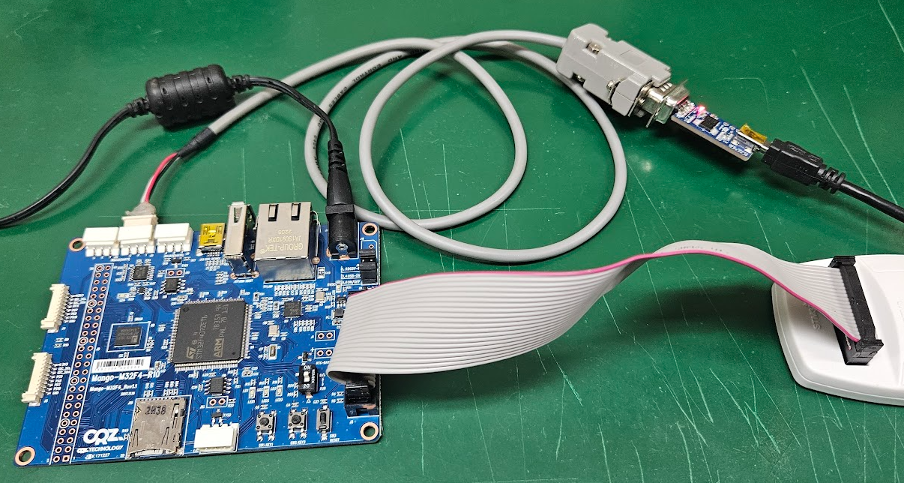
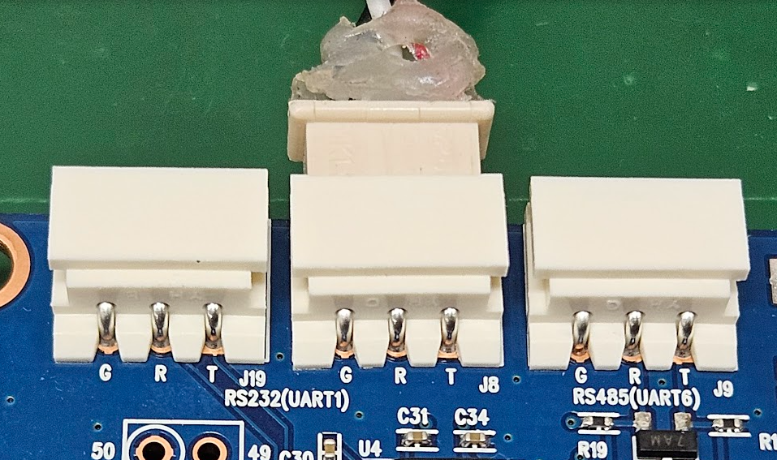
UART Debug 연결 – J8

Slide 3
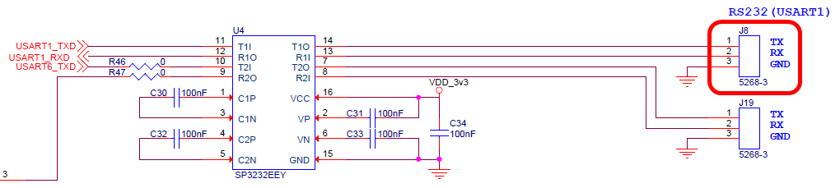
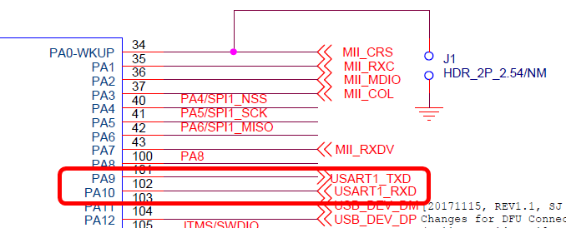
UART Debug 회로도
USART1 – PA9, PA10

Slide 4
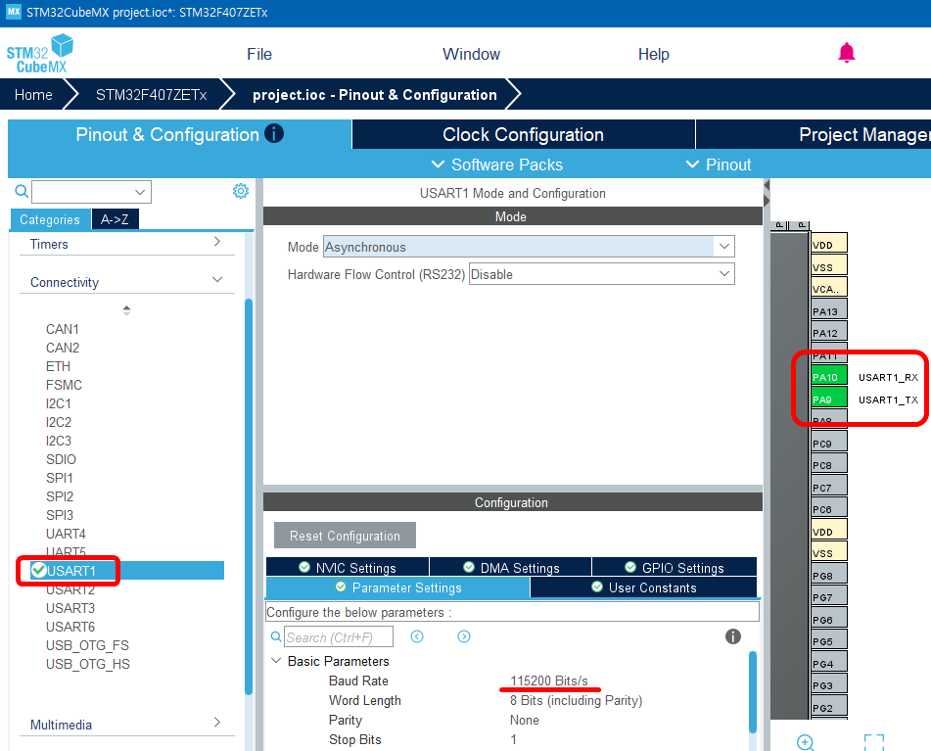
CubeMX USART1 설정

Slide 5
MX_USART1_UART_Init
static void MX_USART1_UART_Init(void)
{
… … … … … …
/* USER CODE END USART1_Init 1 */
huart1.Instance = USART1;
huart1.Init.BaudRate = 115200;
huart1.Init.WordLength = UART_WORDLENGTH_8B;
huart1.Init.StopBits = UART_STOPBITS_1;
huart1.Init.Parity = UART_PARITY_NONE;
huart1.Init.Mode = UART_MODE_TX_RX;
huart1.Init.HwFlowCtl = UART_HWCONTROL_NONE;
huart1.Init.OverSampling = UART_OVERSAMPLING_16;
if (HAL_UART_Init(&huart1) != HAL_OK)
{
Error_Handler();
}
… … … … … …
}

Slide 6
Semi-Hosting 구현
#ifdef __GNUC__
/* With GCC, small printf (option LD Linker->Libraries->Small printf
set to 'Yes') calls __io_putchar() */
#define PUTCHAR_PROTOTYPE int __io_putchar(int ch)
#else
#define PUTCHAR_PROTOTYPE int fputc(int ch, FILE *f)
#endif /* __GNUC__ */
PUTCHAR_PROTOTYPE
{
if(ch == '\n') {
ch = '\r';
HAL_UART_Transmit(&huart1, (uint8_t *)&ch, 1, 0xFFFF);
ch = '\n';
HAL_UART_Transmit(&huart1, (uint8_t *)&ch, 1, 0xFFFF);
}else {
HAL_UART_Transmit(&huart1, (uint8_t *)&ch, 1, 0xFFFF);
}
return ch;
}

Slide 7
main
/* Private includes ----------------------------------------------------------*/
/* USER CODE BEGIN Includes */
#include <stdio.h>
int main(void)
{
… … … … … …
/* Infinite loop */
/* USER CODE BEGIN WHILE */
while (1)
{
printf("Hello World! - Mango ^)^\n");
HAL_Delay(1000);
… … … … … …
}

Slide 8
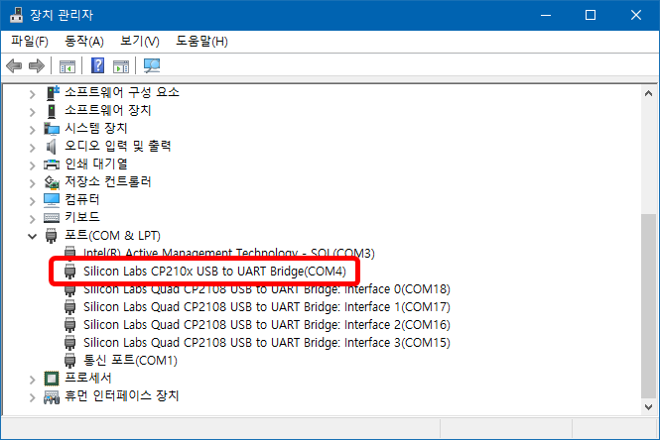
장치관리자 연결
PC에 연결해서 장치관리자의 COM port 확인

Slide 9
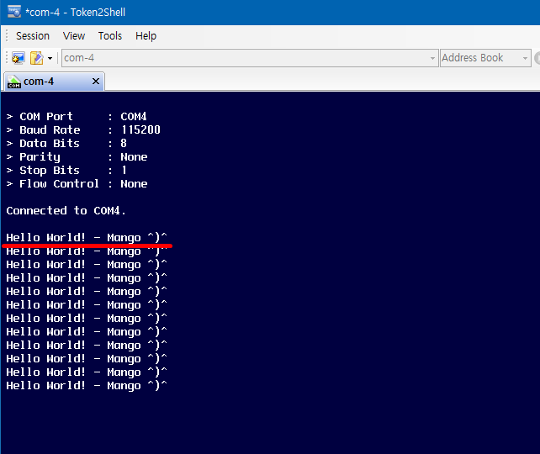
실행 결과
1초에 한번씩 문자열 출력

